Slide 1
Leveraging Nature

Slide 2
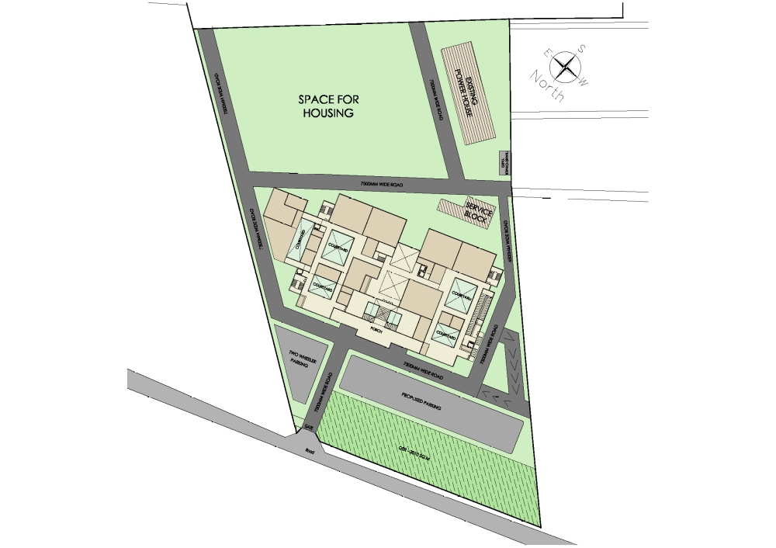
BUILDING ORIENTATION
LONGER AXIS OF THE BUILDING IS ALONG EAST - WEST DIRECTION
CLINICS AND ROOMS PLANNED ON THE NORTH SOUTH SIDE OF THE BUILDING TO REDUCE HEAT
SITE PLAN

Slide 3
COURTYARD – Lighting & Ventilation
COURTYARD BRINGING
DAY LIGHT AND
VENTILATION
SITE PLAN

Slide 4
COURTYARD – Lighting & Ventilation
RAMP & STAIRCASE PLANNED ON THE WEST SIDE OF THE BUILDING TO REDUCE HEAT GAIN
SITE PLAN

